Slide 1
Town of Charlestown
Water System
Interconnection Presented by David Fenstermacher, pe
September 2020
Notes:
Cover Option 2

Slide 2
Arsenic
Long-term exposure to arsenic from drinking-water and food can cause cancer and skin lesions. It has also been associated with cardiovascular disease and diabetes. In utero and early childhood exposure has been linked to negative impacts on cognitive development and increased deaths in young adults.(WHO)

Slide 3
Where We Are At
In 2019, arsenic level allowed in public drinking water was reduced 10 parts per billion (ppb) to 5 ppb.
North Charlestown water system is contaminated with high arsenic levels of 8-11 ppb.
Current treatment system costs has increased fourfold in recent years
Filtration system is substandard for long term.
Low production of the contaminated well also restricts growth production for development.
All of these items are jeopardizing the economic viability of the North Charlestown water system

Slide 4
Options
Provide interconnect between Charlestown and North Charlestown (14,000 feet)
Current well is rated for 4 times Charelstown’s total infrastructure
Consideration of new wells in N. Charlestown.
Installing additional filtration systems

Slide 5
Filtration/Well Risks
Filtration may not work
Excessive annual costs for filtration, pumps, hazardous waste removal
Increased costs for maintenance, operation and testing
Filtration system is only good for 7-10 years
Restrict capacity and growth
New well is likely to tap the same contaminated aquafer or reduced production

Slide 6
Interconnect Benefits
No arsenic or other contaminants
Bull run can handle 4 times Charlestown’s total capacity
Increase the number of users
Allow for future development in North Charlestown (Rt 12 and 12a corridor)
Resolve capacity and water pressure issues with Hidden Valley and Hidden Acres residents
Reduced maintenance and operating costs
Reduce testing costs
Avoid state fines for non-compliance
Provide safe and healthy water to our North Charlestown residents

Slide 7
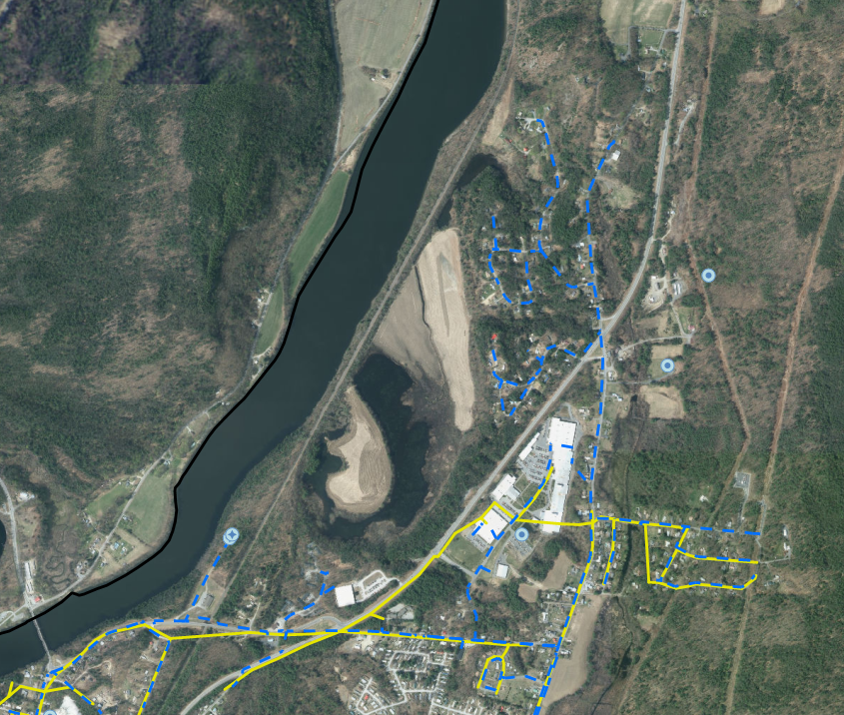
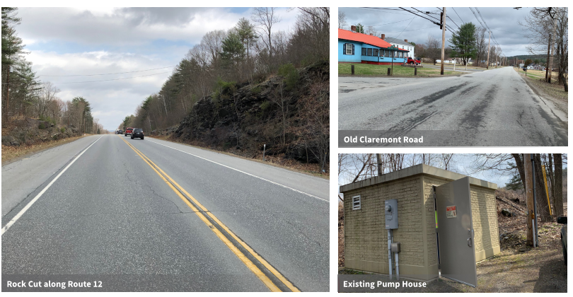
Layout Considerations
Town control of roadways
Minimizing NHDOT approvals for Use and Occupancy agreements and excavation permits.
Avoid potential blasting in Route 12 corridor.
Potential connection locations for current residents off the municipal line.

Slide 8
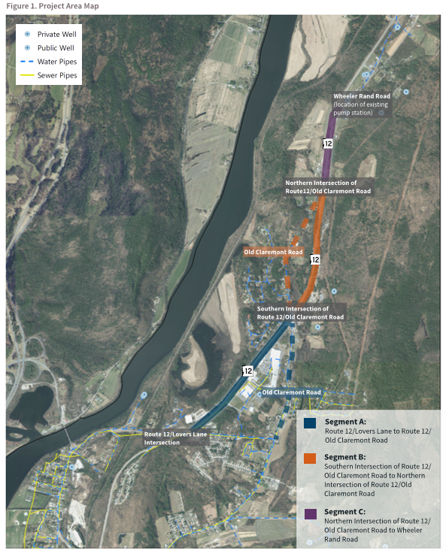
Layout Considerations
Lovers Lane to Old Claremont Road.
Crossing of Route 12, continuing Old Claremont Road
Final leg along Route 12 to Wheeler Rand to existing pump station.

Slide 9
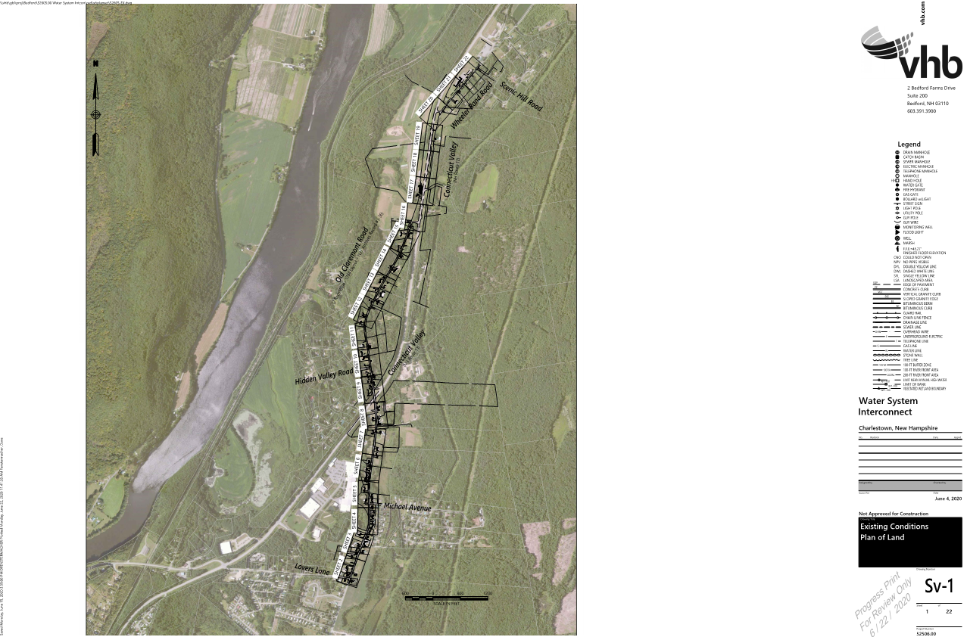
Project Status
Initial services – Workplan, Data Collection, Review of Routing Options, Review of Modeling, and Basis of Design Memorandum
Based on preferred route, performed Survey and Wetlands Delineation.
Grant Applications
USDA
DWGTF

Slide 10
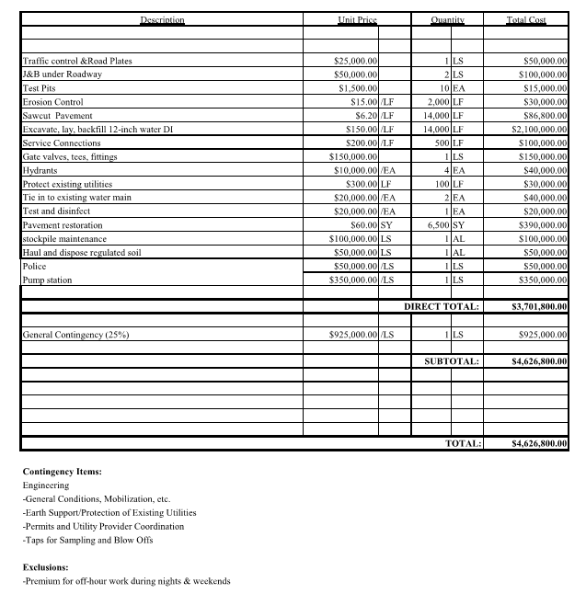
Project Costs

Slide 11
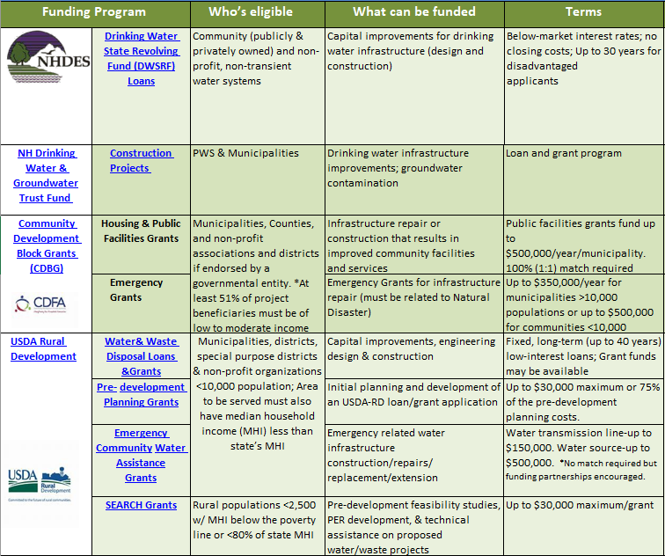
Funding

